Slide 1
Microwave Devices E511
Lecture 5
Amr Al.Awamry

Slide 2
Agenda
Why Network Analysis?
IMPEDANCE AND EQUIVALENT VOLTAGES AND CURRENTS
IMPEDANCE AND ADMITTANCE MATRICES
THE SCATTERING MATRIX

Slide 3
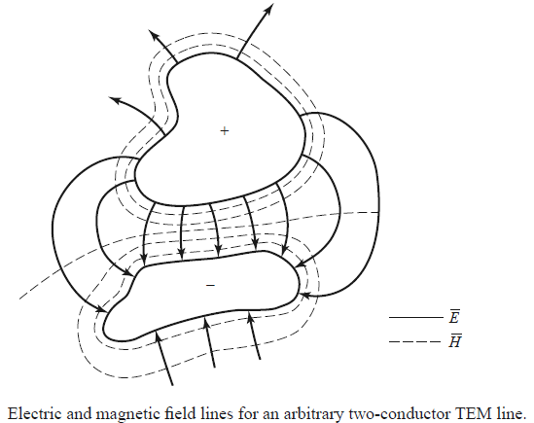
Equivalent Voltages and Currents
It’s impossible almost to measure V & I in microwave circuits
For TEM transmission in co-axial
cable

Slide 4
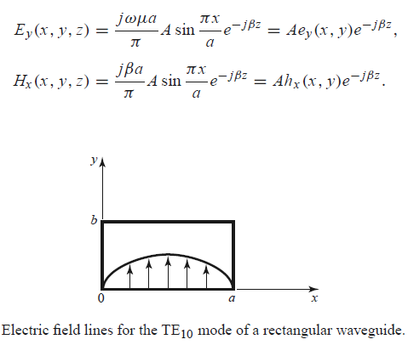
Voltage in TE₁₀ rectangular WG

Slide 5
In arbitrary RWG

Slide 6
Impedance concept
Intrinsic impedance for a media
Waveguide impedance
Characteristic impedance for transmissionline
Even and Odd Properties of Z(ω) and Г(ω)

Slide 7
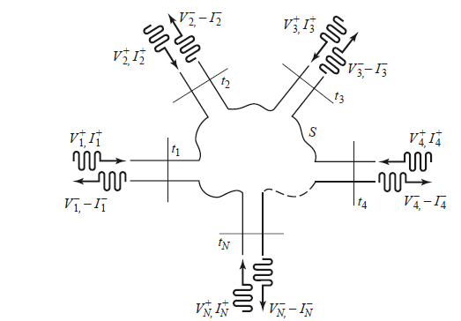
IMPEDANCE AND ADMITTANCE MATRICES

Slide 8
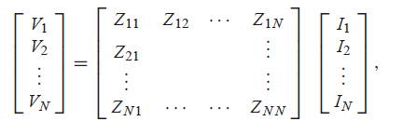
IMPEDANCE AND ADMITTANCE MATRICES … cont

Slide 9
IMPEDANCE AND ADMITTANCE MATRICES … cont
Example

Slide 10
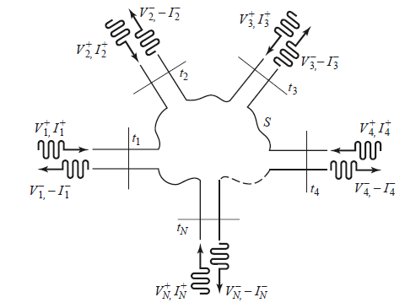
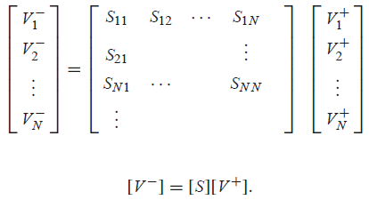
THE SCATTERING MATRIX

Slide 11
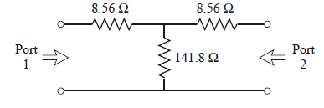
Scattering matrix example

